Slide 1
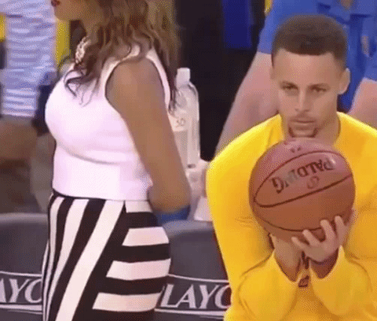
Predicting Success
Analyzing basketball game statistics with Machine Learning to determine a win or loss

Slide 2

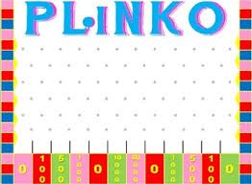
What is Machine Learning?
Machine Learning is a method used in Predictive Analytics, where the computer is given a set of data and tasked to find the correlation between the points.
In Supervised Learning, the computer is given examples of correct values, whereas Unsupervised Learning requires the computer to create its own structure from nothing.

Slide 3
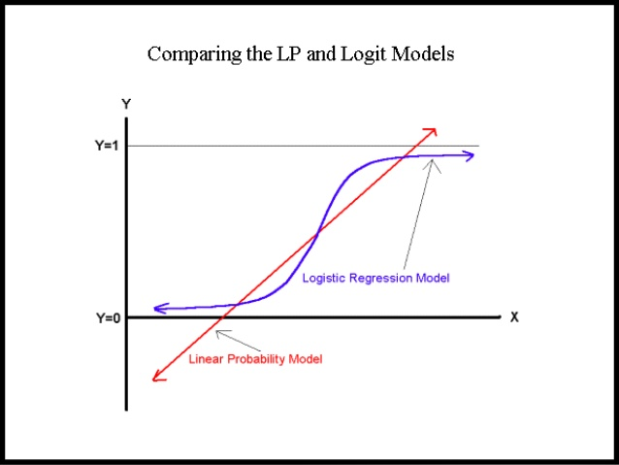

Using a Logistic Regression
Logistic Regression is the optimal method for a binary dependent model and one or more static depended model.
In a Linear Regression, the value may exceed the boundaries of 0 and 1, whereas a Logistic Regression requires a value in between the limits.

Slide 4
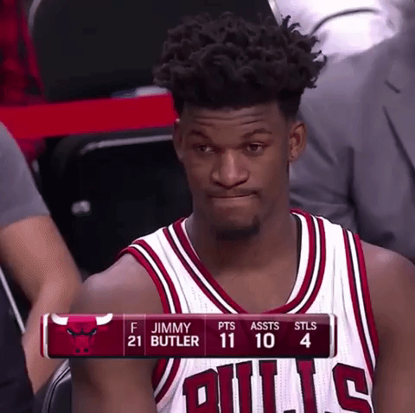
Questions to Ask
Can we predict whether a team won or lost a game based on a few statistics?
Which statistics can most accurately predict a win or loss?
What could be used to improve the accuracy of the model?

Slide 5
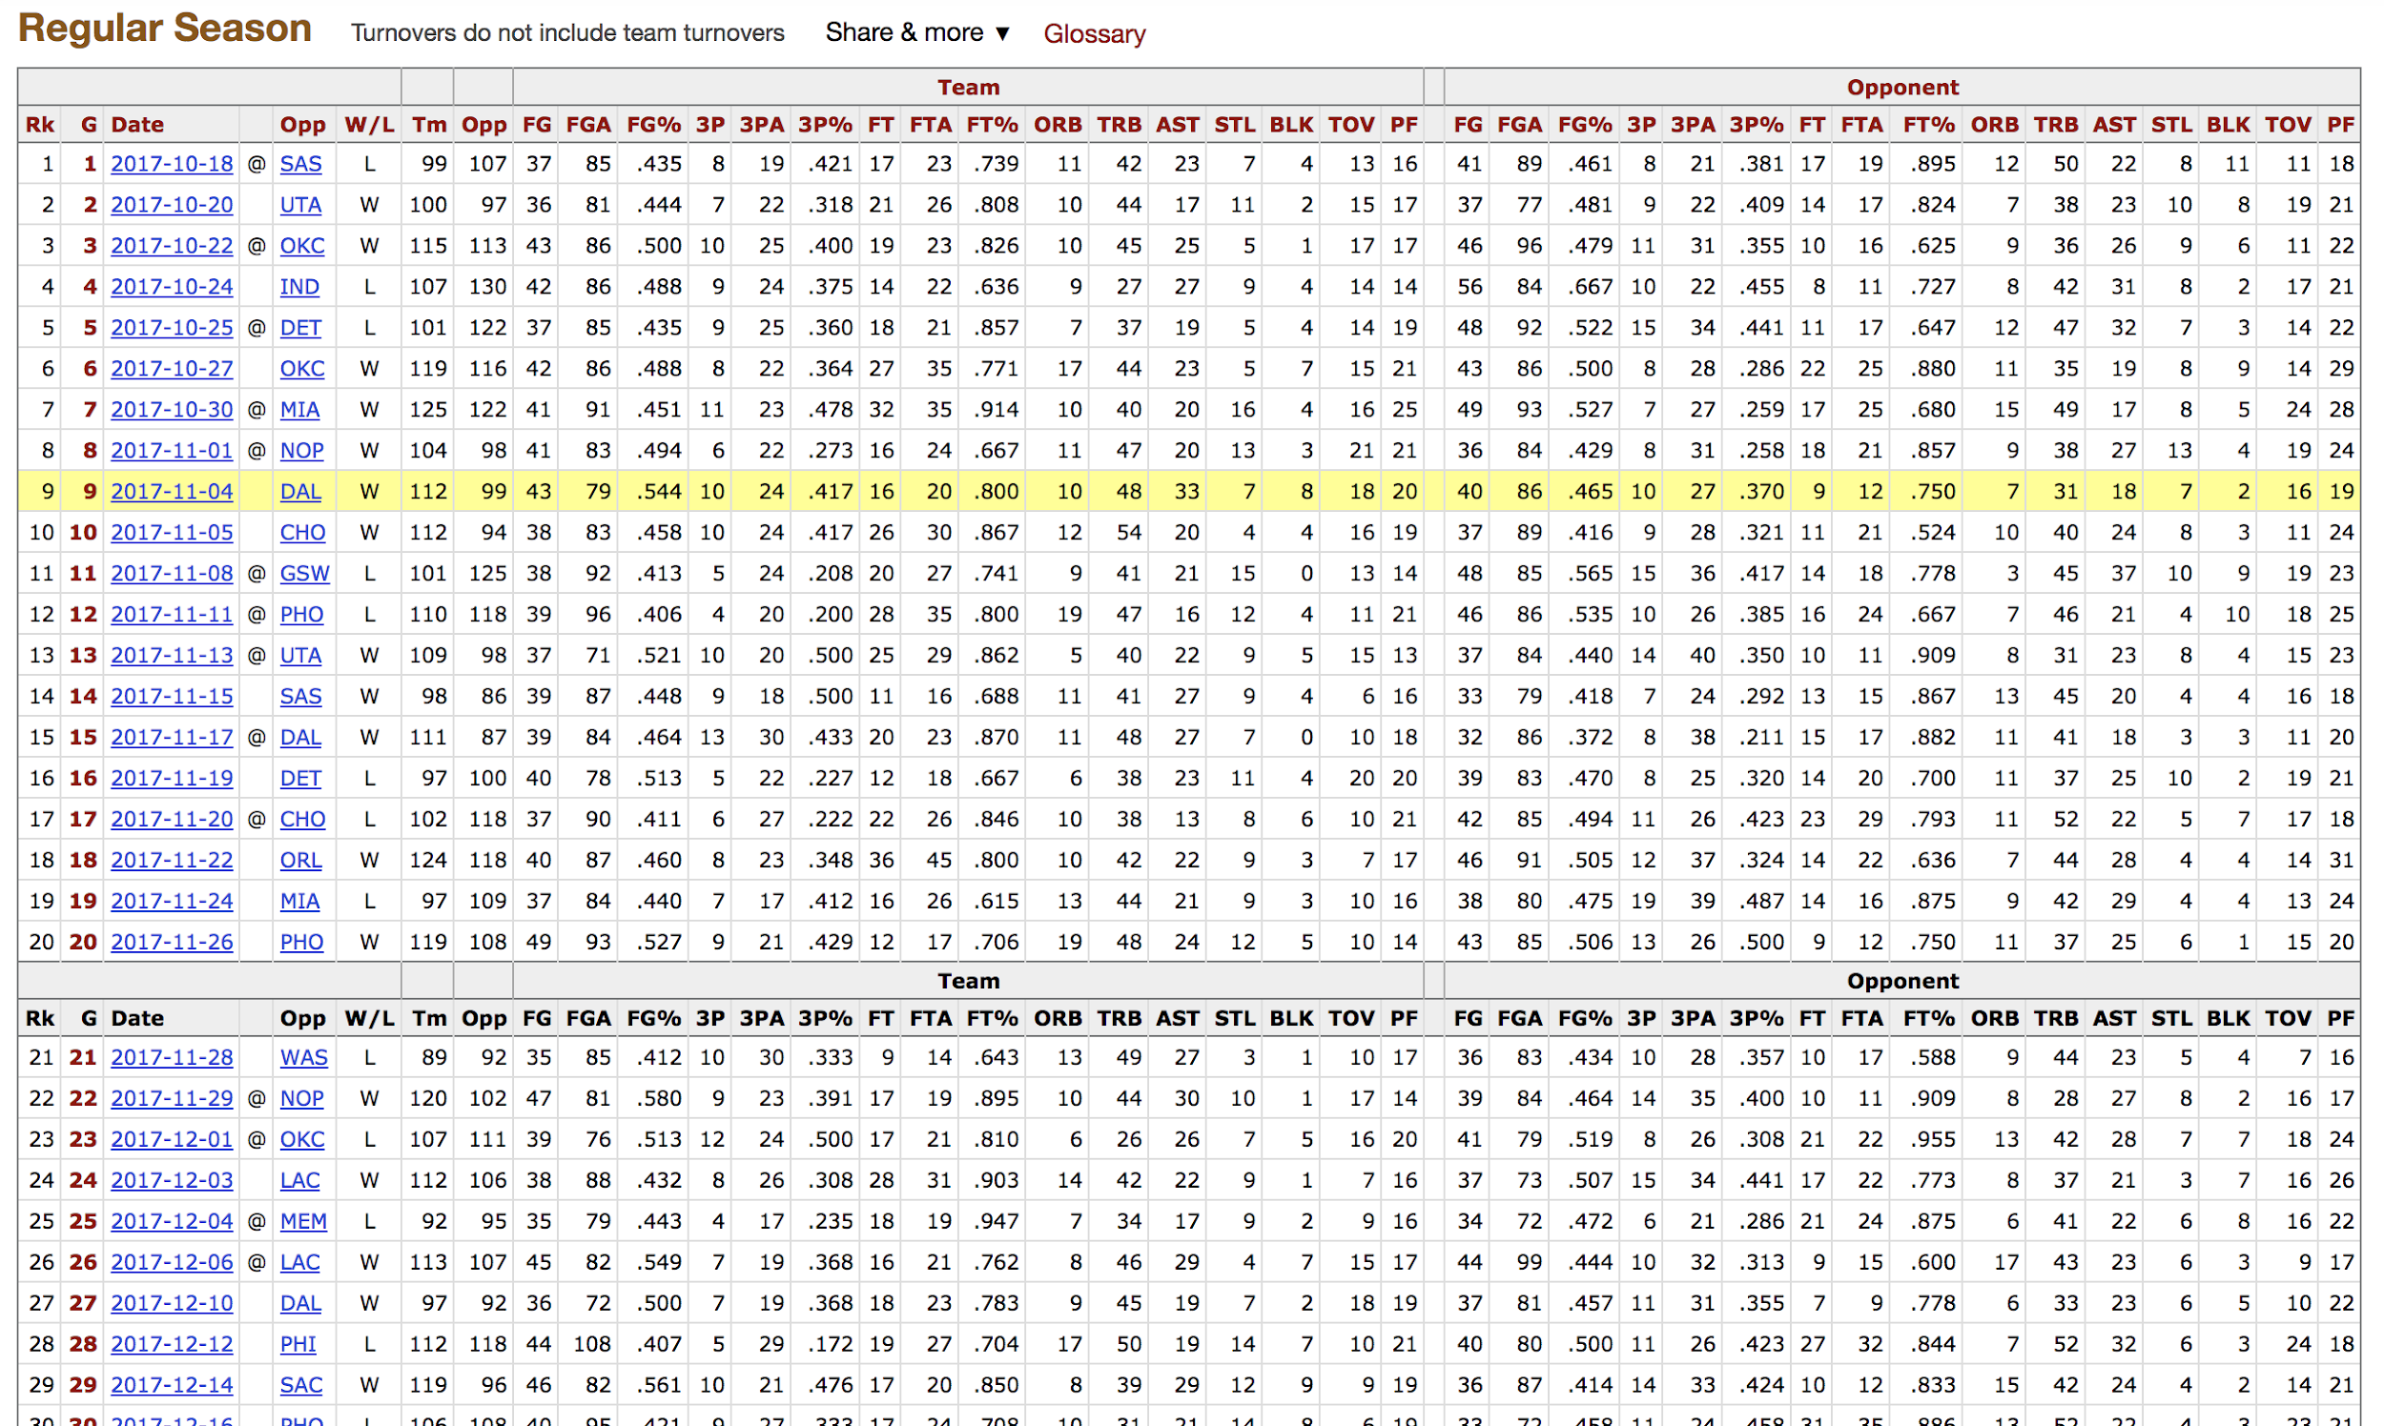
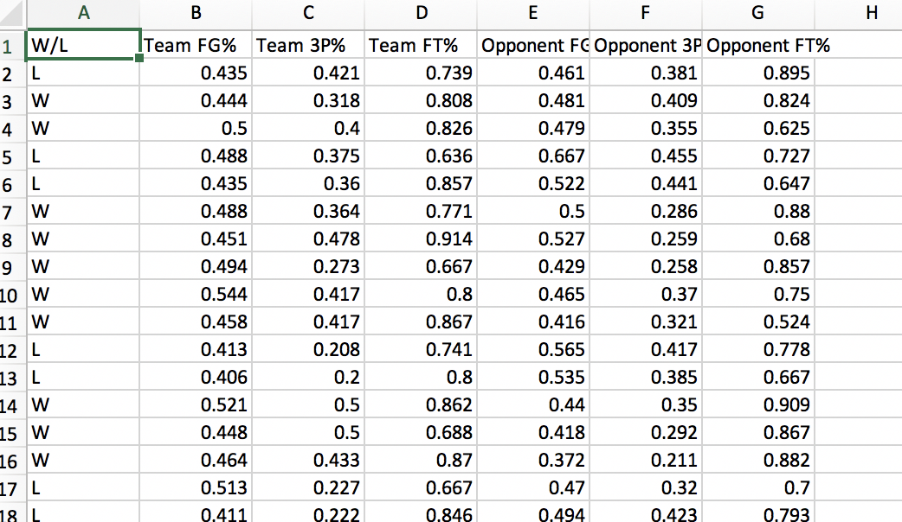
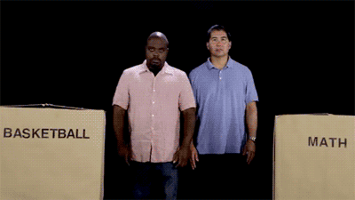
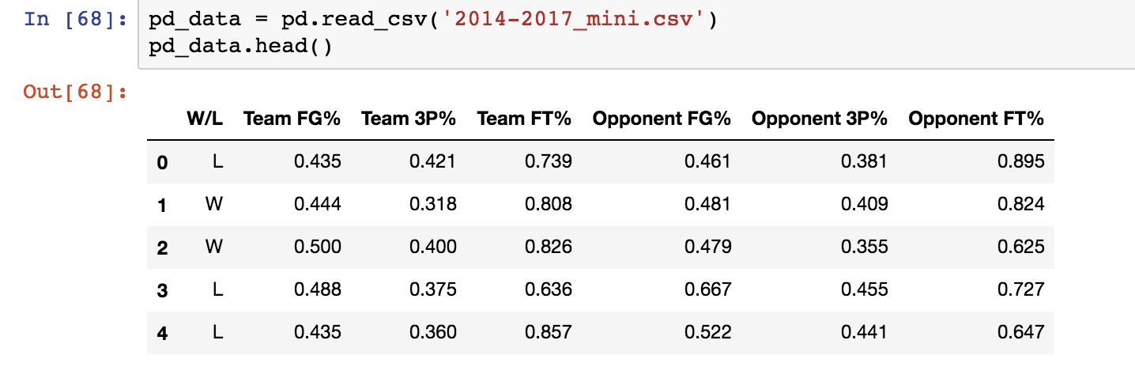
Finding and Cleaning the Data
We found comprehensive game-by-game statistics on basketball-reference.com. We trimmed the original data set down to seven columns: W/L, Team FG%, Team FT%, Opponent FG%, Opponent 3P%, Opponent FT%.

Slide 6

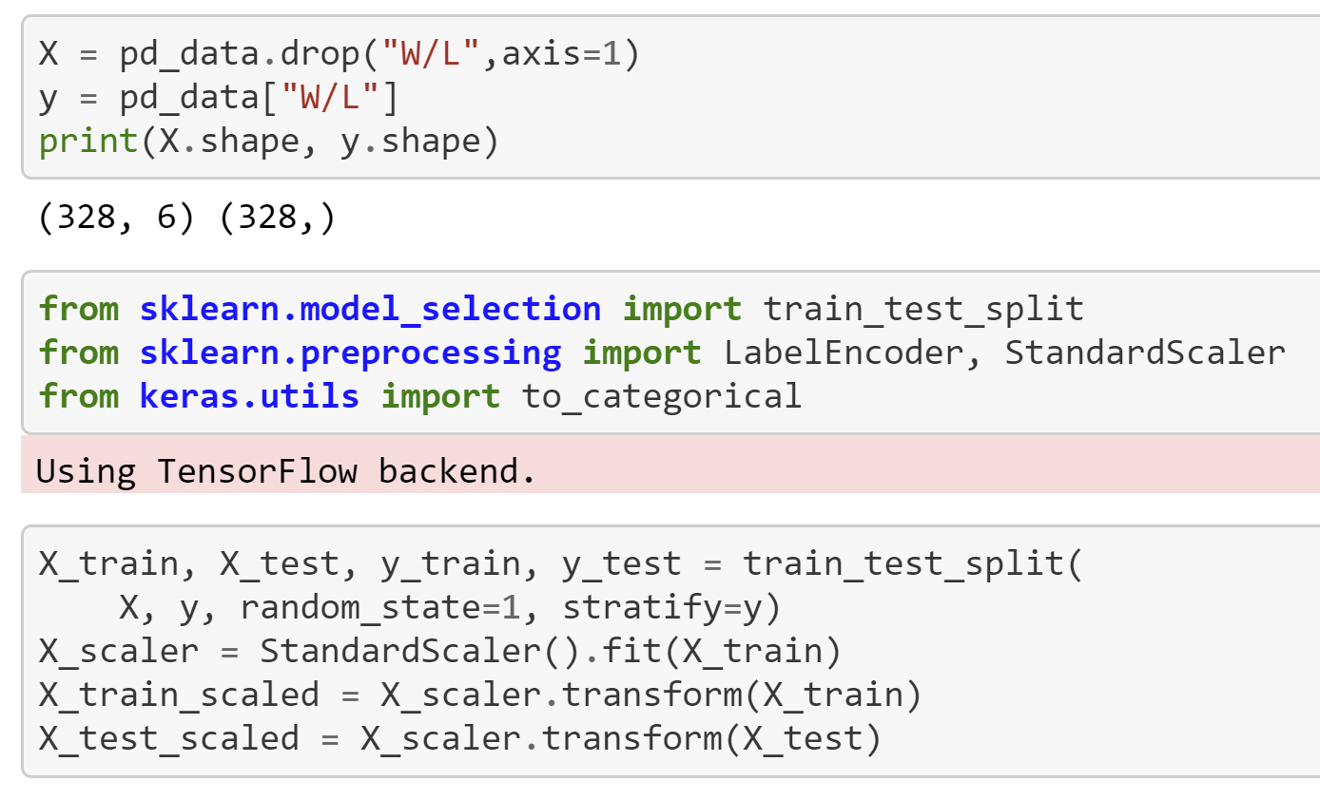
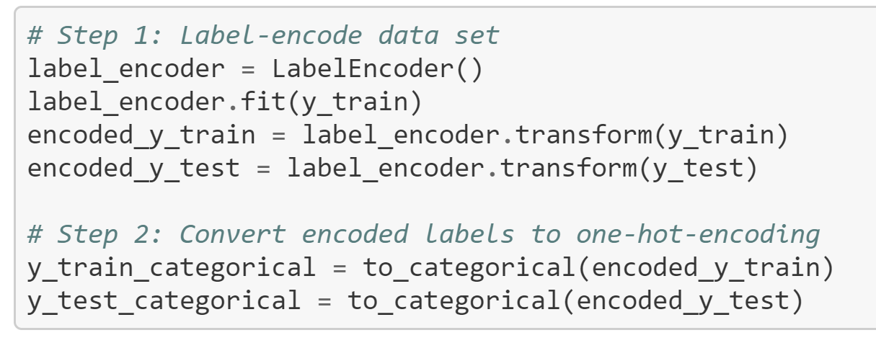
Training/Testing and Data Preprocessing
Split the dataset into independent and dependent values. We set the “W/L” column as the dependent variable; Team FG%, Team 3P%, Team FT%, Opponent FG%, Opponent 3P%, and Opponent FT% comprise the independent variables we trained on.

Slide 7
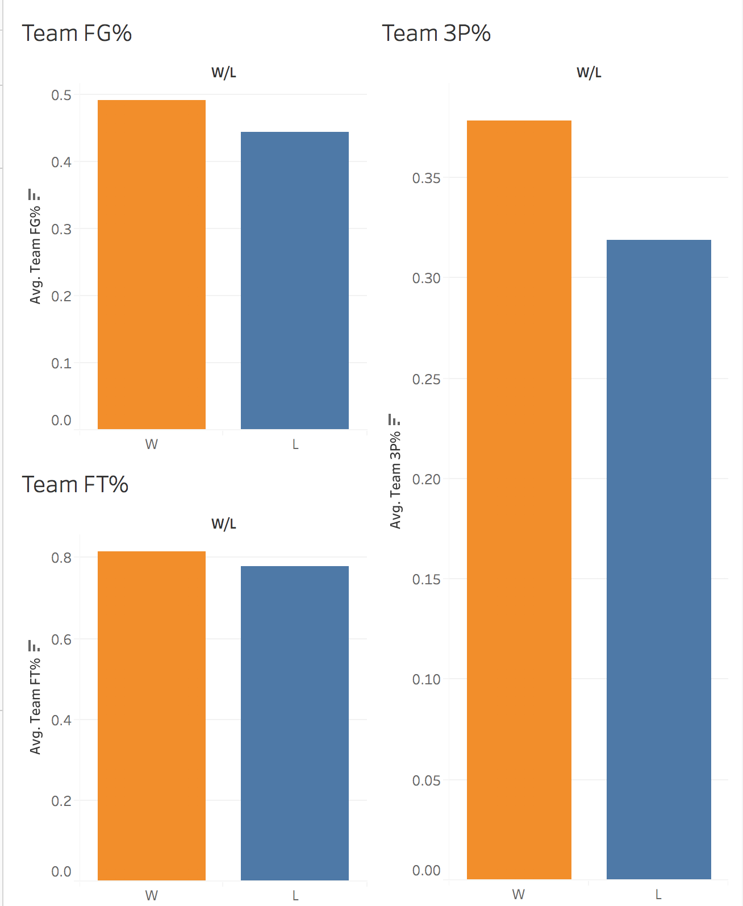
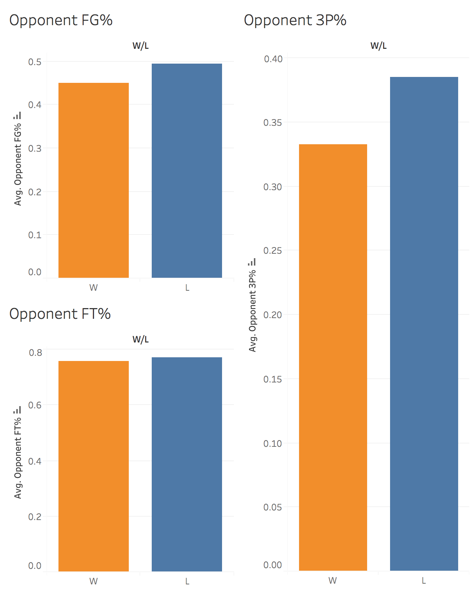

Slide 8
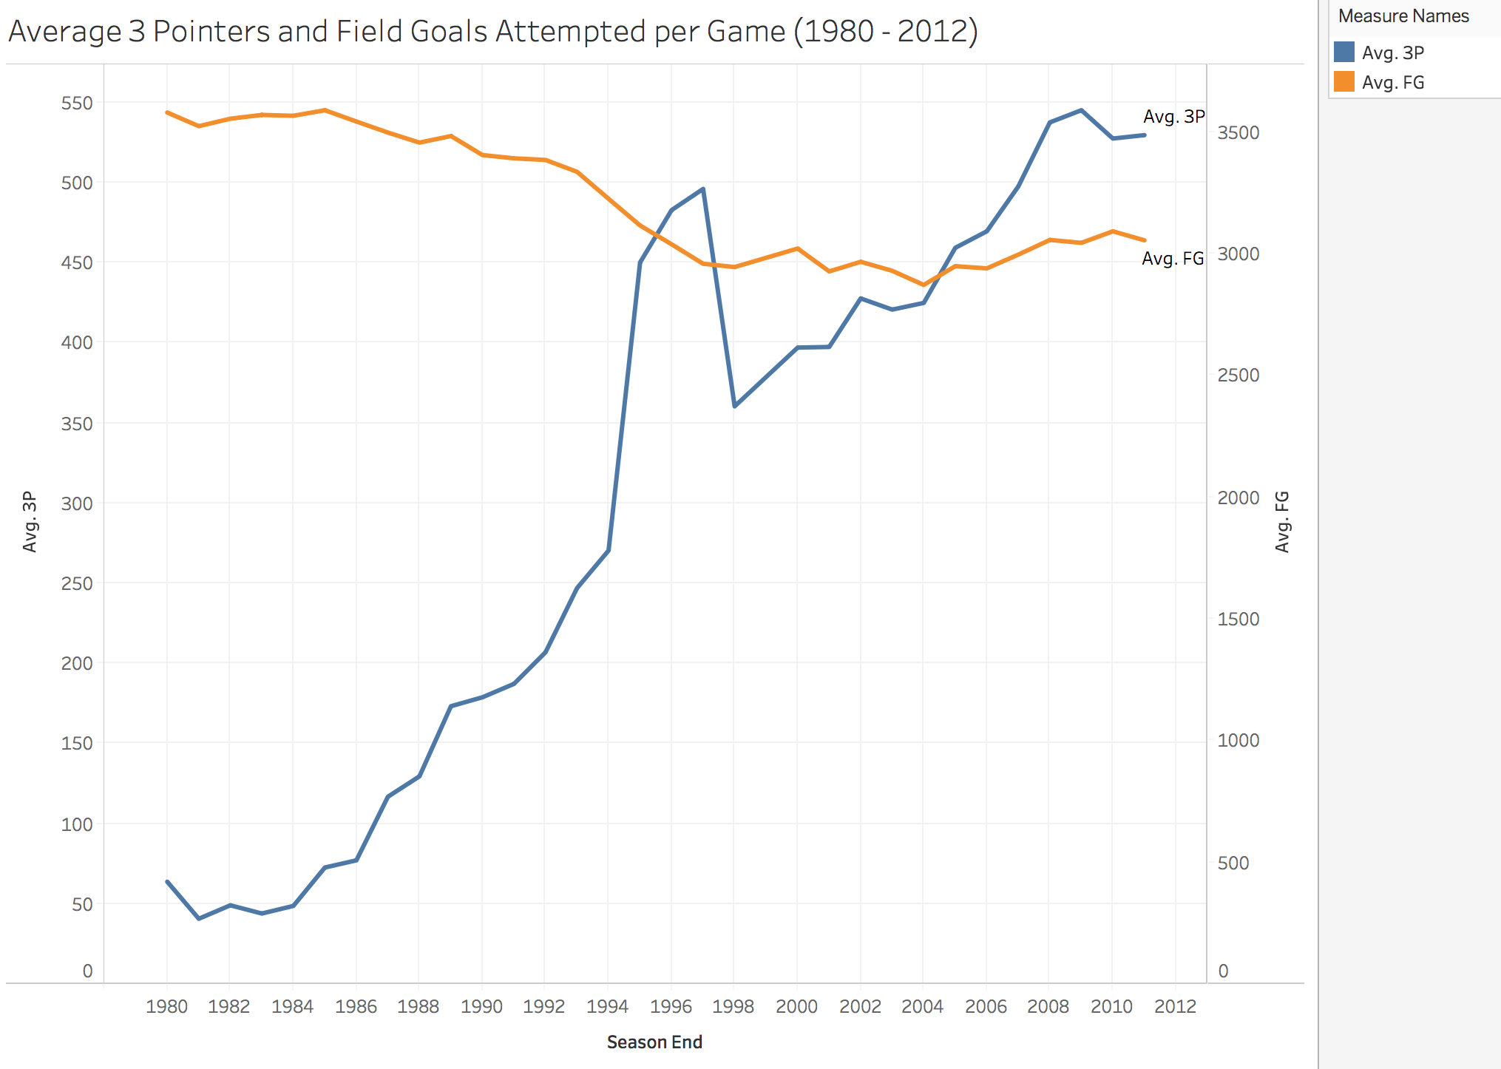

Evolution of the Three Pointer

Slide 9

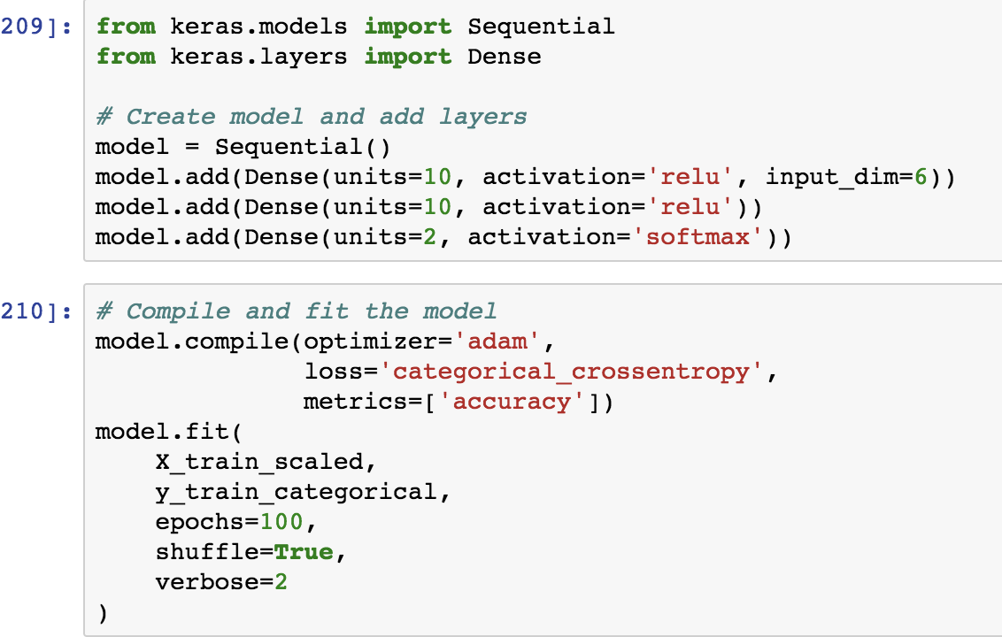
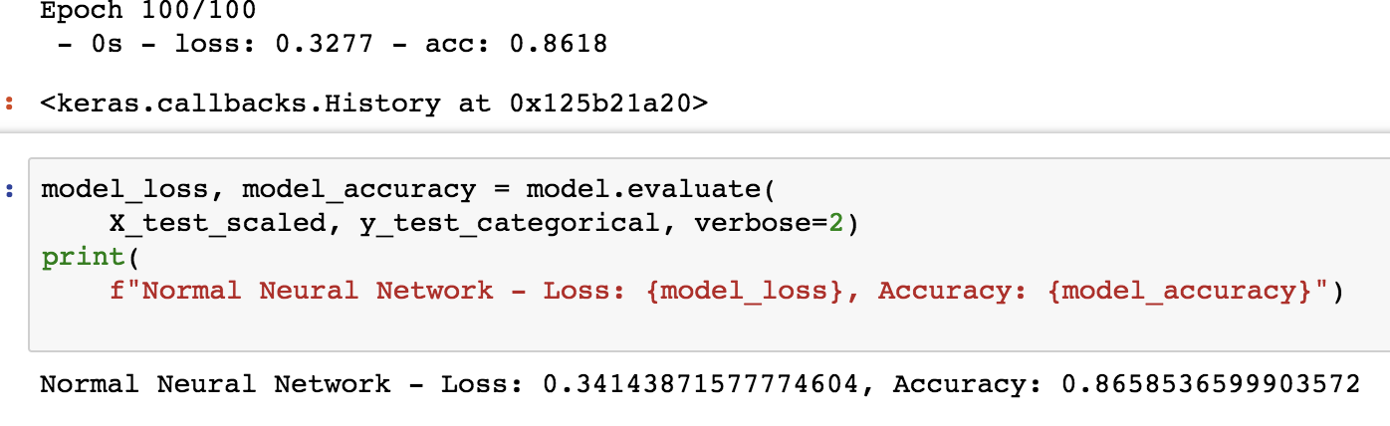
Initiate Neural Network
Initiate a neural network with two hidden layers of ten units each. We achieved an accuracy of just under 86% with a loss of ~0.34. Notice that we ran the model through 100 epochs.

Slide 10
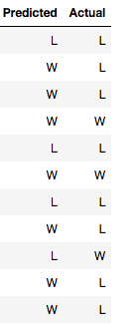
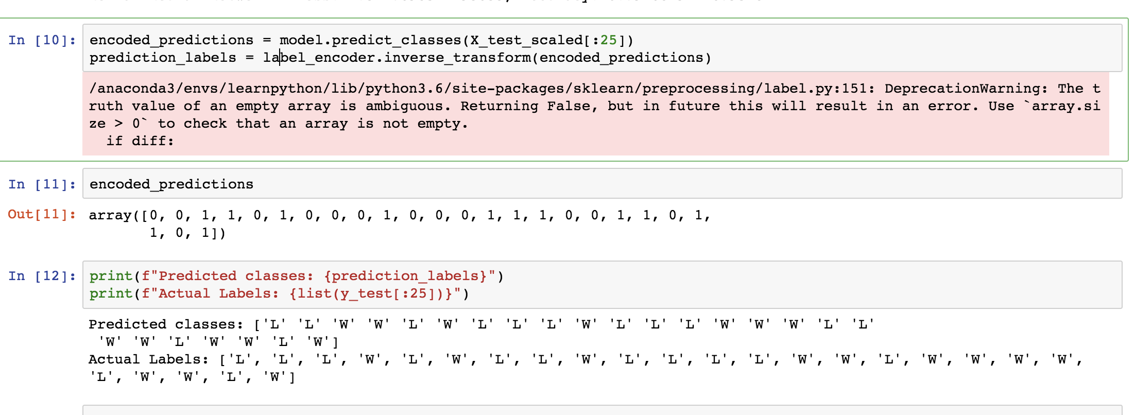
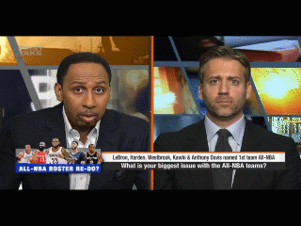
Making Predictions
Make predictions and encode them. Label encoded class predictions and test out against actual classes. Here we can see from a snapshot that our predictions weren’t perfect. Stephen A. isn’t sure how to feel...

Slide 11
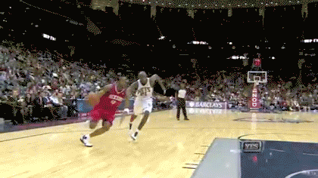
Insights and Next Steps
Experiment with other non-scoring statistics to see if other metrics fare better
Experiment with coefficient values to weight different statistics
Experiment with historical data to see if style of play from different eras affect the accuracy

Slide 12

End of Regulation
Thank you for your time!

Slide 13

Questions?

